Slide 1



An Introduction
A Healthcaa Group Company
June 2025
Singapore | Harrow | Bangalore | Gurugram | Mumbai
www.healthcaa.com

Slide 2

Our foundations are rooted in recruiting for Global Institutions & Companies…
Xenith Workforce Solutions is a sector focused search firm that has built its foundations on recruiting senior management for Global Institutions & Companies across the key territories.
In India we engage with organizations of every size and denomination and provide the reach of a service that befits an international organization, with the touch, sensitivity and specialism of the high customer service associated with boutique consultancies.
www.healthcaa.com

Slide 3
The Xenith Advantage

Slide 4
The Xenith Advantage
1
Comprehensive understanding
of the industry
We focus exclusively on the strategic hiring in Product & Service based organization, Service based organization in both parts C2H as well as full time placements….

Slide 5
The Xenith Advantage
2
Extensive network in
the Banking & Financial
industry
Leveraging on our network in India, USA and Europe

Slide 6
The Xenith Advantage
3
Staffing Organization
with Technical Assessments.
Partner level engagement at all levels, not just at inception. We remain personally responsible for the execution of all roles.

Slide 7
The Xenith Advantage
4
No off-limit clients
Greater market coverage and access to the best candidates. Get candidates those who fit correctly to your requirements.

Slide 8
The Xenith Advantage
5
Track record of working
on cross-border roles across
India, US and EU.
Seamless working through our offices in India and serving globally. Over 1000+ assignments executed successfully

Slide 9



Our Approach
Focus on deliverables
We use performance metrics as a beacon for candidate search
We work collaboratively with clients to ensure a comprehensive JD for the role
We use the JD also as a marketing tool to emphasize and highlight the company
Diligent Research
We execute our proprietary research system to perform an effective search relying on diligent process.
We never have to start a search from scratch; we always have a rich dataset of trusted contacts.
Our network is as wide as it is deep, encompassing key geographies and relationships nurtured over decades.
Delivering Access to High
Level Talent-base
We deliver high-level access to the world‘s talent base.
We know our markets and have deep connections within the Information Technology ecosystem to identify the most suitable candidate.
We understand the implications of each candidate‘s career history and current role.

Slide 10


Our Approach
Comprehensive Candidate
Evaluation, including cultural-fit
We comprehensively evaluate all candidates to ensure best-fit and have the experience to engage with the most senior candidate.
We incorporate the implications of differing culture to the building of high-performance teams
We evaluate not just the current role but the evolution of a candidate‘s career to ensure best fit, both culturally and role-wise.
Validated Shortlist
We provide validated introductions, not just CVs
We informally reference all candidates before presenting them on a shortlist.
This informal referencing (via industry peers and seniors) helps us differentiate top flight deal makers from talented but unexceptional professionals with detail not generated by interview or assessment of CVs

Slide 11

Our Footprints: We serve Globally…

Slide 12






















Clients (Recruitment)
www.healthcaa.com

Slide 13





















Clients (Recruitment)
www.healthcaa.com

Slide 14













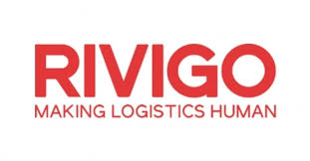









Clients (Recruitment)
www.healthcaa.com

Slide 15


















Clients (Recruitment)
www.healthcaa.com

Slide 16






























Clients (Recruitment)

Slide 17

What more we can bring on Table for our Clients?

Slide 18
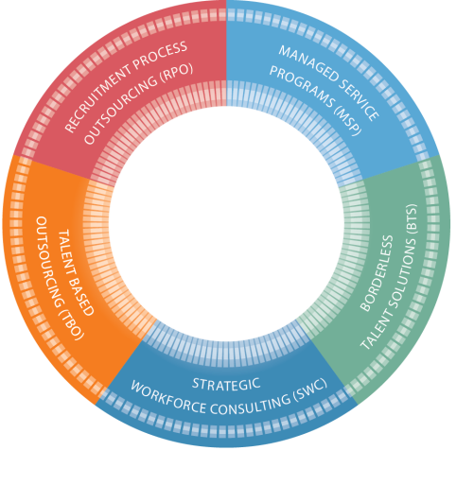

Xenith Workforce – What We Do…
Xenith Workforce Solutions helps clients win by designing and delivering innovative workforce solutions that leverage our global and local capability, comprehensive solutions, and collaborative approach and practical creativity. We differentiate our solutions in the marketplace by leveraging these capabilities and by providing our clients with faster time to value.
The solutions offered by Xenith Workforce Solutions can be applied as stand alone solutions or combined with the additional capabilities offered by Relocate Anywhere Solutions.
The Global offerings are:
Recruitment Process Outsourcing (RPO)
Managed Service Provider (MSP)
Talent Based Outsourcing (TBO)
Borderless Talent Solutions (BTS)
Strategic Workforce Consulting (SWC, formerly Black Dog)
www.healthcaa.com

Slide 19


Our Success Stories
Get in touch
Xenith Workforce Solutions
Inspiring Executive Search
Vikas Sharma - +91-78775 41118
vikas@zenithwfm.in
Singapore | Jaipur | Bangalore | Gurugram | Mumbai

